Slide 1

ProspHER
US Market Expansion Strategy
Team ProsperUS
^{26/08/2024}

Slide 2
ProspHER
US Market Expansion Strategy
Team ProsperUS
^{26/08/2024}

Slide 3



Project goals
Market Analysis
Opportunity Analysis
Technology
Recommendations

Slide 4

Market Overview
Around 14 million Women Owned Businesses (WOB) in the US
114% increase in WOB over the last 20 years
WOBs generate $2.7 trillion for the US Economy
But is it all sunshine and rainbows?
Notes:
Market Analysis Key statistics on the US market for women entrepreneurs. Include data on growth, trends, and potential market size.
Use infographics, charts, and visual data representations.

Slide 5
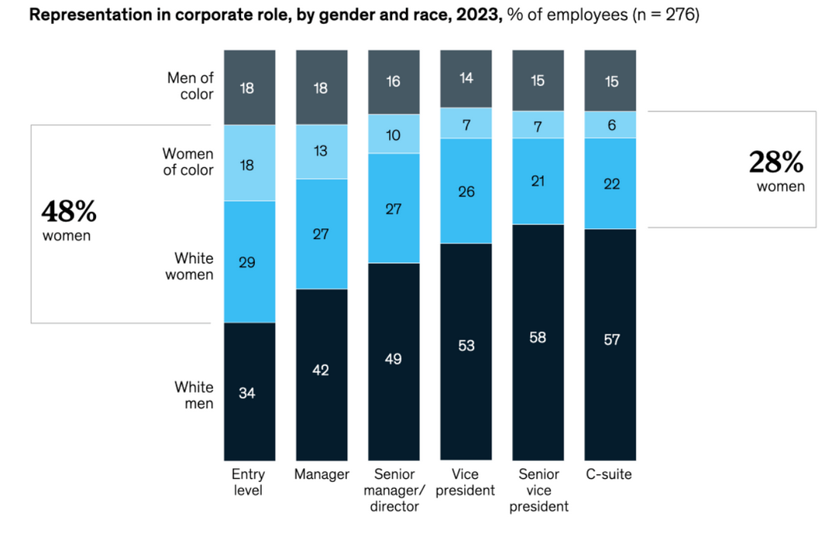
US Barriers to Success
Market Attractiveness
But is it all sunshine and rainbows?
Notes:
Market Analysis Key statistics on the US market for women entrepreneurs. Include data on growth, trends, and potential market size.
Use infographics, charts, and visual data representations.

Slide 6
Market Attractiveness
The Market situation for women professionals can be split into two areas:
The Lucrative Face of the Market
The Face of Existing Inequality
What does this mean for ProspHER?

Slide 7





Slide 8
✅ Diverse audience ✅ Large membership base ✅ 56 corporate partners for networking ❌ Expensive membership ❌Limited accessibility for lower-income women ❌Leadership focus excludes ethnic diversity

Slide 9
✅ Diverse audience ✅ Large membership base ✅ 56 corporate partners for networking ❌ Expensive membership ❌Limited accessibility for lower-income women ❌Leadership focus excludes ethnic diversity
✅ Strong brand recognition with government ties ✅ Established history (49 years) ✅ Diverse revenue streams (6 sources) ❌ Limited audience (from high brand value) ❌Focus mainly on established entrepreneurs

Slide 10
✅ Diverse audience ✅ Large membership base ✅ 56 corporate partners for networking ❌ Expensive membership ❌Limited accessibility for lower-income women ❌Leadership focus excludes ethnic diversity
✅ Strong brand recognition with government ties ✅ Established history (49 years) ✅ Diverse revenue streams (6 sources) ❌ Limited audience (from high brand value) ❌Focus mainly on established entrepreneurs
✅ Diverse audience ✅ Large network with 5000+ events ✅Brand almost 100 years old ❌ Less diverse revenue streams ❌Lacks prestige compared to NAWBO

Slide 11
✅ Diverse audience ✅ Large membership base ✅ 56 corporate partners for networking ❌ Expensive membership ❌Limited accessibility for lower-income women ❌Leadership focus excludes ethnic diversity
✅ Strong brand recognition with government ties ✅ Established history (49 years) ✅ Diverse revenue streams (6 sources) ❌ Limited audience (from high brand value) ❌Focus mainly on established entrepreneurs
✅ Diverse audience ✅ Large network with 5000+ events ✅Brand almost 100 years old ❌ Less diverse revenue streams ❌Lacks prestige compared to NAWBO
✅ Covers niche: tradeswomen ✅Conducts workplace data research ✅ Inclusive nature ❌Small niche market (314k tradeswomen) ❌Limited benefit from business boom ❌Focus lacks career development for PoC

Slide 12
Highest Opportunity States
Lessons from Competitors
• The market is still large enough for ProspHER.
• There are large niches which these organisations don’t cater to as effectively.
• Start-up Founders
• Women in underrepresented fields
• Ethnic Minorities
• Providing more value propositions for members increases what they can expect from the money they invest.

Slide 13
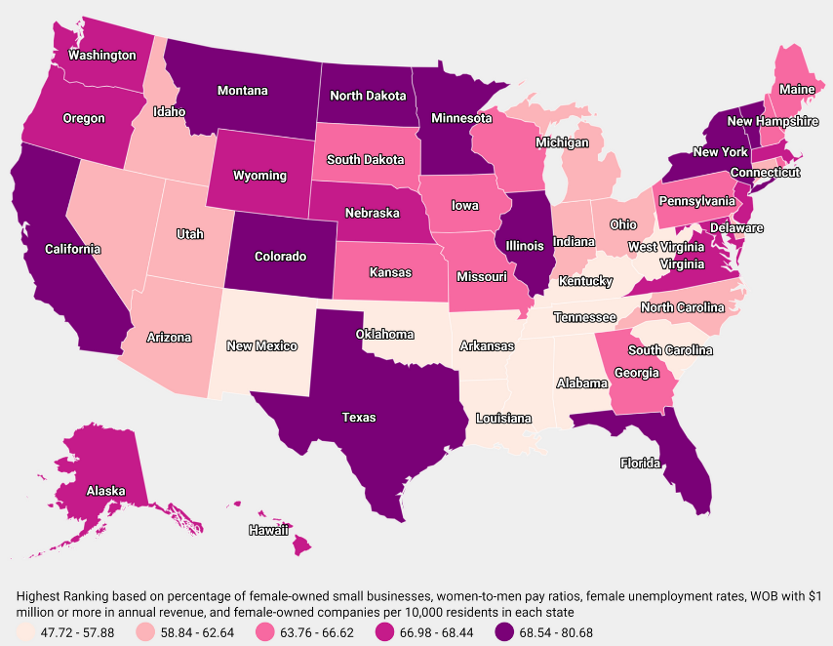
Highest Opportunity States
Notes:
Highlight states with the best conditions for ProspHER's entry, focusing on economic indicators and support for women entrepreneurs.
Map of the US with highlighted states, supported by key statistics.

Slide 14


Highest Opportunity States
New York
Strategic Entry Plan
Top performing state for professional women across the board
Phase 1 – Information Gathering and Preparation
Phase 2 – Marketing and Membership
High employment rates for women
Phase 3 – Partnerships, Networking and Funding
Closest time-zone to the UK to facilitate operations
Phase 4 – The Agile Approach
Phase 5 – Expansion
Notes:
Highlight states with the best conditions for ProspHER's entry, focusing on economic indicators and support for women entrepreneurs.
Map of the US with highlighted states, supported by key statistics.

Slide 15
New York
Legal Barriers to Entry
Strategic Entry Plan
Top performing state for professional women across the board
Phase 1 – Information Gathering and Preparation
Phase 2 – Marketing and Membership
High employment rates for women
Challenges
Mitigation
Phase 3 – Partnerships, Networking and Funding
Intellectual property protection
Data privacy compliance
Contractual disputes
Register and enforce IP rights globally
Implement robust data privacy policies
Standardise contracts with regular legal reviews
Closest time-zone to the UK to facilitate operations
Phase 4 – The Agile Approach
Phase 5 – Expansion
Notes:
Highlight states with the best conditions for ProspHER's entry, focusing on economic indicators and support for women entrepreneurs.
Map of the US with highlighted states, supported by key statistics.

Slide 16


Legal Barriers to Entry
Regulatory Barriers
Strategic Entry Plan
Challenges
Mitigation
Challenges
Mitigation
Licensing/accreditation requirements
Compliance with employment laws
Complex tax regulations
Secure necessary licenses and accreditations
Tailor HR policies to local laws
Optimise tax strategies with professional guidance
Intellectual property protection
Data privacy compliance
Contractual disputes
Register and enforce IP rights globally
Implement robust data privacy policies
Standardise contracts with regular legal reviews
Notes:
Highlight states with the best conditions for ProspHER's entry, focusing on economic indicators and support for women entrepreneurs.
Map of the US with highlighted states, supported by key statistics.

Slide 17
Legal Barriers to Entry
Small Business Export Programs
Strategic Entry Plan
SelectUSA
• Comprehensive resources for UK businesses looking to invest in the US
• Assistance with regulatory requirements
• Insights on how to set up operations
• Networking opportunities through their events
US Commercial Service (USCS)
• Tailored market research
• Business matching services
• Help with regulatory compliances
• Identification on potential partnerships with other organisations
Challenges
Mitigation
Challenges
Mitigation
Licensing/accreditation requirements
Compliance with employment laws
Complex tax regulations
Secure necessary licenses and accreditations
Tailor HR policies to local laws
Optimise tax strategies with professional guidance
Intellectual property protection
Data privacy compliance
Contractual disputes
Register and enforce IP rights globally
Implement robust data privacy policies
Standardise contracts with regular legal reviews
Notes:
Highlight states with the best conditions for ProspHER's entry, focusing on economic indicators and support for women entrepreneurs.
Map of the US with highlighted states, supported by key statistics.

Slide 18




Partnerships
Large Corporations
Job Development Organisations

Slide 19
Partnerships
Job Development Organisations
Large Corporations
Amber Grant
Monthly grants of $10,000 & Annual grant of $25,000
Robin Hood Foundation
Grants over $100,000

Slide 20
Grants
US General Grant:
Amber Grant
Monthly grants of $10,000 & Annual grant of $25,000
Job Development Organisations
New York Grant:
Robin Hood Foundation
Grants over $100,000

Slide 21
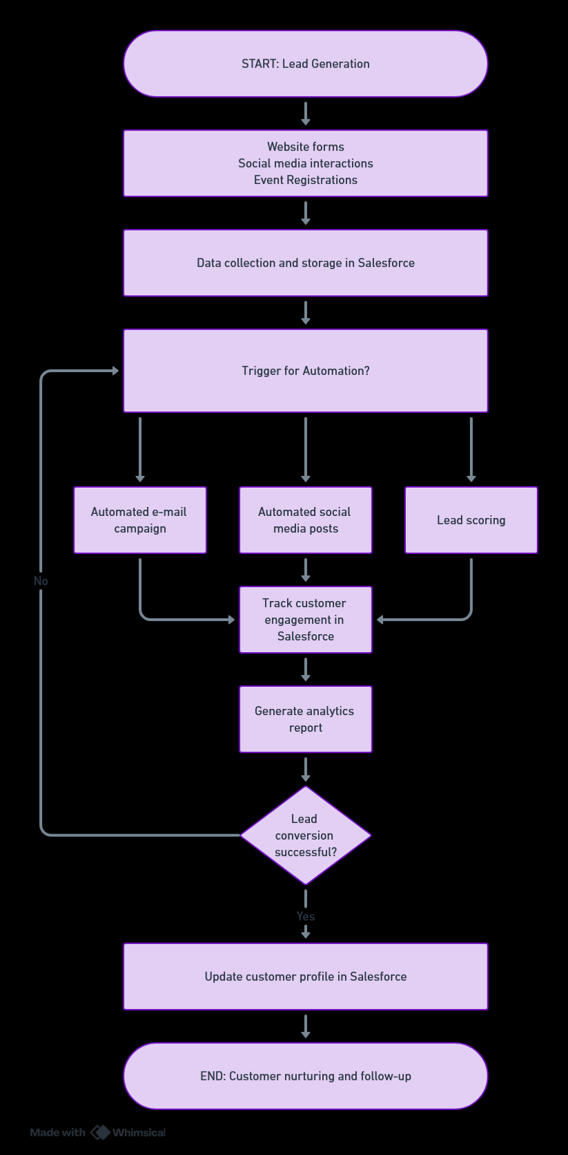






AI and Automation

Slide 22


Slide 23
Notes:
Technology Overview
Introduction to the key technologies ProspHER should implement (Salesforce, Zapier, etc.).
Technology logos with brief descriptions of their benefits.
Show how these technologies can be integrated using a real-life example or case study, perhaps focusing on the New York market.
Use a flowchart (like the one previously discussed) to show the implementation process.

Slide 24


More Affordable
Less Features

Slide 25
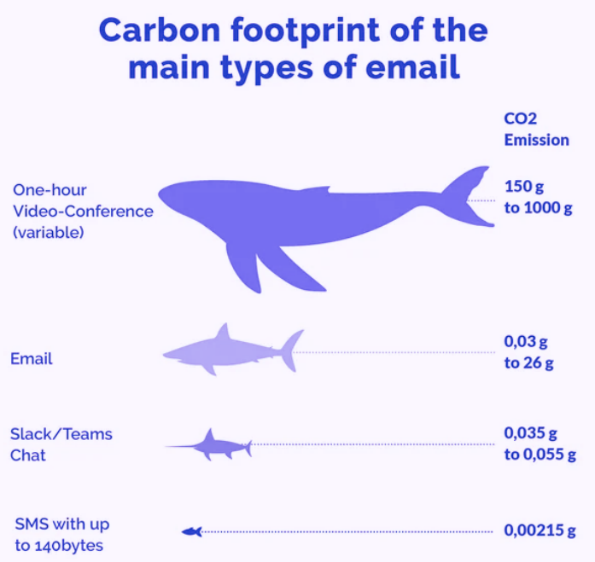
Sustainability Practices
Transitioning operations online.
Remove unnecessary emails from all events.
Zero-waste ProspHER FESTs.
Notes:
1- Radical Carbon Reduction:
Remote Work Mandate: Slash emissions by reducing commutes.
Energy Efficiency Overhaul: Upgrade all facilities.
Carbon Offsetting Commitment: Neutralize our operational footprint.
2- Transformative Eco-Friendly Operations:
Total Digital Shift: Eliminate paper use.
Zero-Waste Events: Set new standards in sustainability.
Sustainable Sourcing Partnerships: Only work with ethical, green suppliers.

Slide 26




Recommendations
Notes:
1) Social media management Social media manager
Brand visibility
2) 2) Corporate membership programs Launch packages
Client loyalty and market position
3) 3) Job - development organizations Private to government bodies
Increase women in work and standard of work

